Slide 1
Statistics
ESSCA
MASTER OF SCIENCE in FINANCIAL ANALYSIS
Achraf Seddik
seddik.achraf.1@gmail.com

Slide 2
Summary
Recall : Descriptive statistics
Statistical modeling : Probability distributions and estimation
Confidence Intervals
Statistical tests
Regressions

Slide 3
Chapter I - Descriptive statistics

Slide 4
Chapter I - Descriptive statistics
1. Terminology
2. Measures of central tendency :
Mean
Mode
Median
3. Measures of central dispersion :
Range
Interquartile Range
Mean absolute deviation
Variance and Standard deviation
4. Data Visualization : Barplots, Histograms, Boxplots

Slide 5
1. Terminology
Population : A set of similar elements which is of interest for some question or experiment. A statistical population can be a group of existing elements (e.g. the set of all people populating France) or a hypothetical group of objects conceived as a generalization from experience (e.g. the set of all possible equity combinations in a portfolio). A common aim of statistical analysis is to produce information about some chosen population.
Sample : A data sample is a set of data collected and/or selected from a statistical population by a defined procedure. The elements of a sample are known as sample points, sampling units or observations.
Statistical variable : A property or quantity that is recorded over a statistical population (E.g. Age, Gender, Occupation etc.)
Statistical modalities : The set of possible values or observations of a statistical variable. Each individual of the population has a unique modality for each variable (E.g. individual “A” has 26 years old).
Qualitative variable : A statistical variable is said to be qualitative (or categorical) if its modalities are not measurable. Modalities of a qualitative variable are categories to which each individual is assigned. Categories should be exhaustive and exclusive (i.e. each individual belongs to a unique category). E.g. of qualitative variable : Gender (Modalities : “male”, “female”).

Slide 6
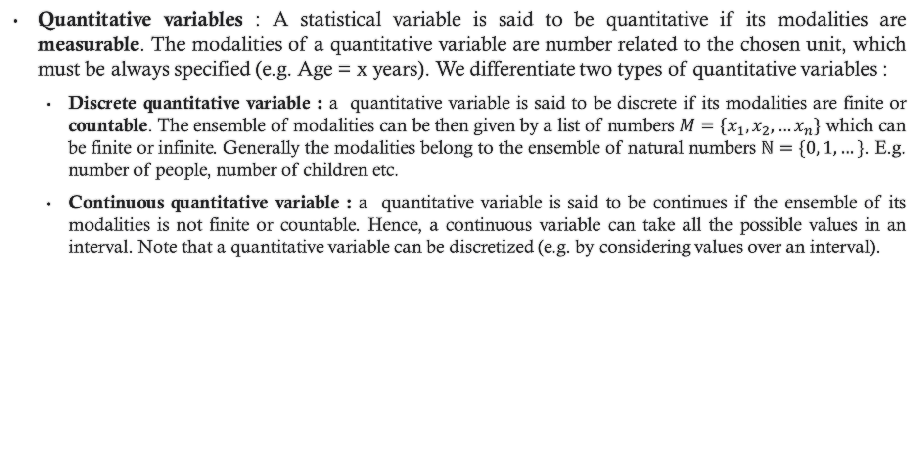
1. Terminology
Quantitative variables : A statistical variable is said to be quantitative if its modalities are measurable. The modalities of a quantitative variable are number related to the chosen unit, which must be always specified (e.g. Age = x years). We differentiate two types of quantitative variables :
Discrete quantitative variable : a quantitative variable is said to be discrete if its modalities are finite or countable. The ensemble of modalities can be then given by a list of numbers $M=\{x_{1}, x_{2},…x_{n}\}$ which can be finite or infinite. Generally the modalities belong to the ensemble of natural numbers $ℕ=\{0, 1,…\}$. E.g. number of people, number of children etc.
Continuous quantitative variable : a quantitative variable is said to be continues if the ensemble of its modalities is not finite or countable. Hence, a continuous variable can take all the possible values in an interval. Note that a quantitative variable can be discretized (e.g. by considering values over an interval).

Slide 7
2. Measures of central tendency
A useful way to summarize (describe) a statistical series of observations (or variable) is to describe the position of its center (i.e. central tendency).
The most common ways of describing the central tendency are mode, mean and quantiles (specifically median).
2.1. Mode : (denoted Mo)
The mode of a given variable is the modality (or value) associated with the highest number of occurrences (i.e. the value that appears most often, or the value that has the highest frequency).
2.2. Mean :
Can be qualified as the center of the observations. Different means can be computed. These include arithmetic mean, weighted arithmetic mean, Geometric mean or Quadratic mean.

Slide 8
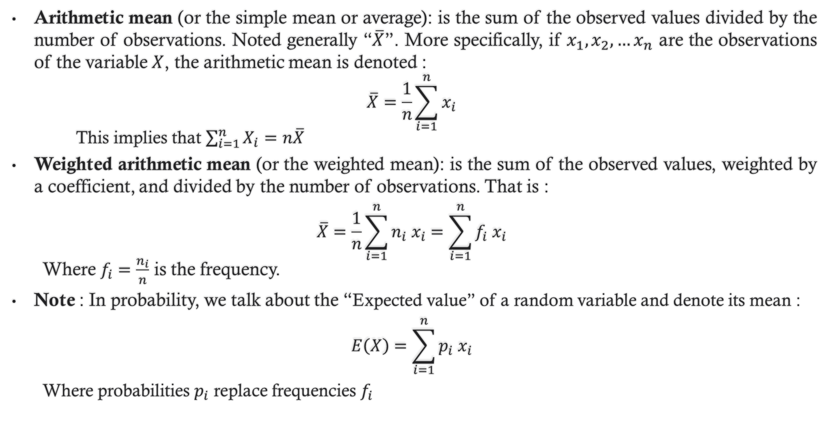
2. Measures of central tendency
Arithmetic mean (or the simple mean or average): is the sum of the observed values divided by the number of observations. Noted generally “$\overline{X}$”. More specifically, if $x_{1}, x_{2},…x_{n}$ are the observations of the variable $X$, the arithmetic mean is denoted :
$$\overline{X}=\frac{1}{n}\sum_{i=1}^{n}{x_{i}}$$
This implies that $\sum_{i=1}^{n}{X_{i}}=n\overline{X}$
Weighted arithmetic mean (or the weighted mean): is the sum of the observed values, weighted by a coefficient, and divided by the number of observations. That is :
$$\overline{X}=\frac{1}{n}\sum_{i=1}^{n}{n_{i} x_{i}}=\sum_{i=1}^{n}{{f_{i} x}_{i}}$$
Where $f_{i}=\frac{n_{i}}{n}$ is the frequency.
Note : In probability, we talk about the “Expected value” of a random variable and denote its mean :
$$E\left(X\right)=\sum_{i=1}^{n}{p_{i} x_{i}}$$
Where probabilities $p_{i}$ replace frequencies $f_{i}$

Slide 9
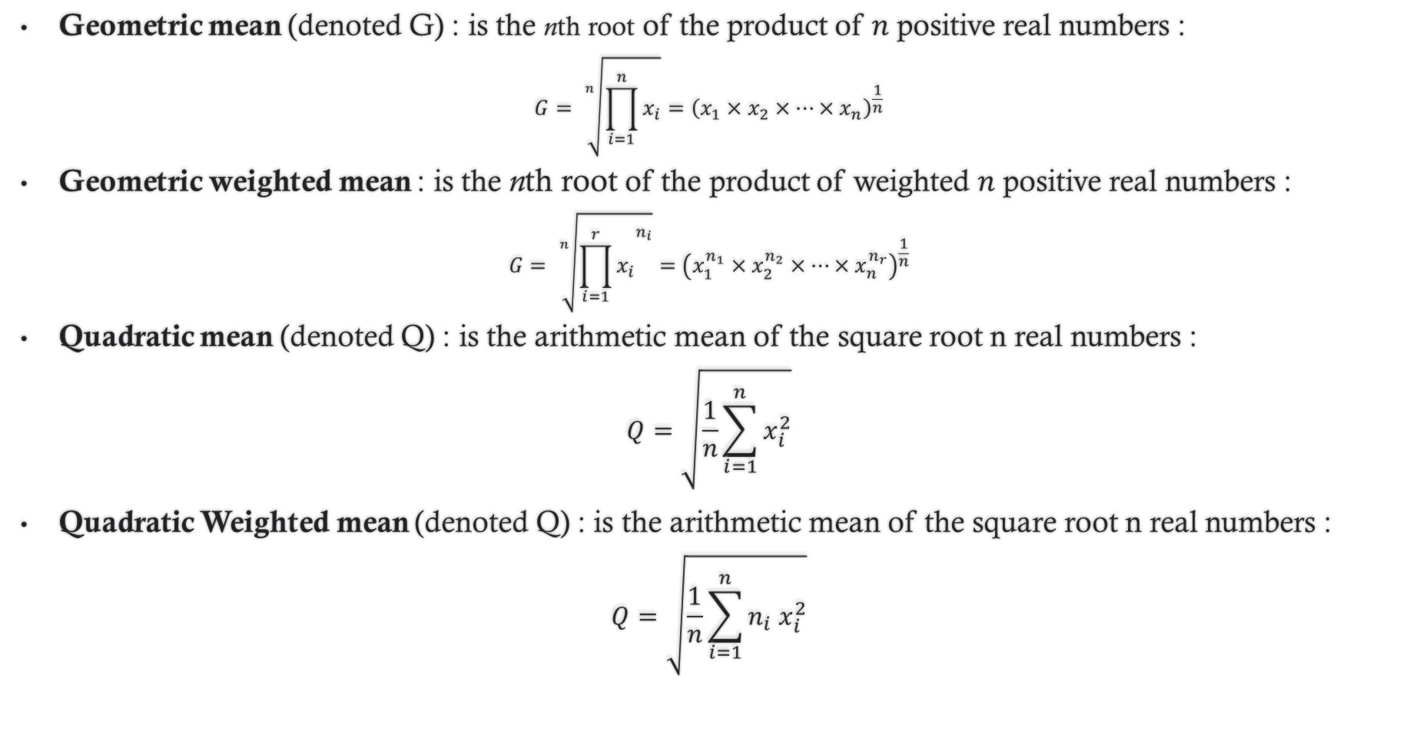
2. Measures of central tendency
Geometric mean (denoted G) : is the nth root of the product of $n$ positive real numbers :
$$G= \sqrt[n]{\prod_{i=1}^{n}{x_{i}}}={\left(x_{1}×x_{2}×…×x_{n}\right)}^{\frac{1}{n}}$$
Geometric weighted mean : is the nth root of the product of weighted $n$ positive real numbers :
$$G= \sqrt[n]{{\prod_{i=1}^{r}{x_{i}}}^{n_{i}}}={\left(x_{1}^{n_{1}}×x_{2}^{n_{2}}×…×x_{n}^{n_{r}}\right)}^{\frac{1}{n}}$$
Quadratic mean (denoted Q) : is the arithmetic mean of the square root n real numbers :
$$Q=\sqrt{\frac{1}{n}\sum_{i=1}^{n}{x_{i}^{2}}}$$
Quadratic Weighted mean (denoted Q) : is the arithmetic mean of the square root n real numbers :
$$Q=\sqrt{\frac{1}{n}\sum_{i=1}^{n}{{n_{i} x}_{i}^{2}}}$$

Slide 10
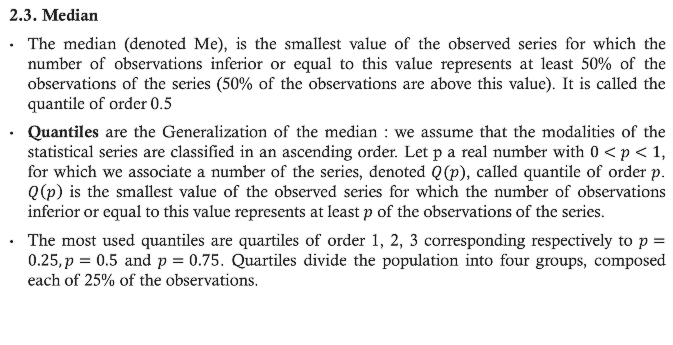
2. Measures of central tendency
2.3. Median
The median (denoted Me), is the smallest value of the observed series for which the number of observations inferior or equal to this value represents at least 50% of the observations of the series (50% of the observations are above this value). It is called the quantile of order 0.5
Quantiles are the Generalization of the median : we assume that the modalities of the statistical series are classified in an ascending order. Let p a real number with $0<p<1$, for which we associate a number of the series, denoted $Q(p)$, called quantile of order $p$. $Q\left(p\right)$ is the smallest value of the observed series for which the number of observations inferior or equal to this value represents at least $p$ of the observations of the series.
The most used quantiles are quartiles of order 1, 2, 3 corresponding respectively to $p=0.25, p=0.5$ and $p=0.75$. Quartiles divide the population into four groups, composed each of 25% of the observations.

Slide 11
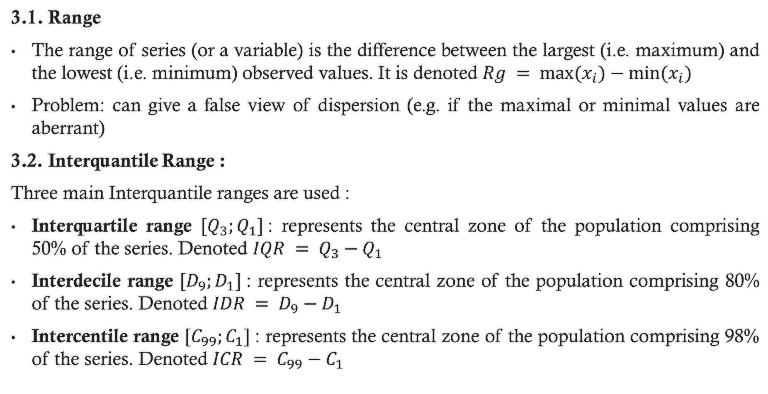
3. Measures of dispersion
3.1. Range
The range of series (or a variable) is the difference between the largest (i.e. maximum) and the lowest (i.e. minimum) observed values. It is denoted $Rg = max⁡(x_{i})−min⁡(x_{i})$
Problem: can give a false view of dispersion (e.g. if the maximal or minimal values are aberrant)
3.2. Interquantile Range :
Three main Interquantile ranges are used :
Interquartile range $[Q_{3};Q_{1}]$: represents the central zone of the population comprising 50% of the series. Denoted $IQR = Q_{3}−Q_{1}$
Interdecile range $[D_{9};D_{1}]$: represents the central zone of the population comprising 80% of the series. Denoted $IDR = D_{9}−D_{1}$
Intercentile range $[C_{99};C_{1}]$: represents the central zone of the population comprising 98% of the series. Denoted $ICR = C_{99}−C_{1}$

Slide 12
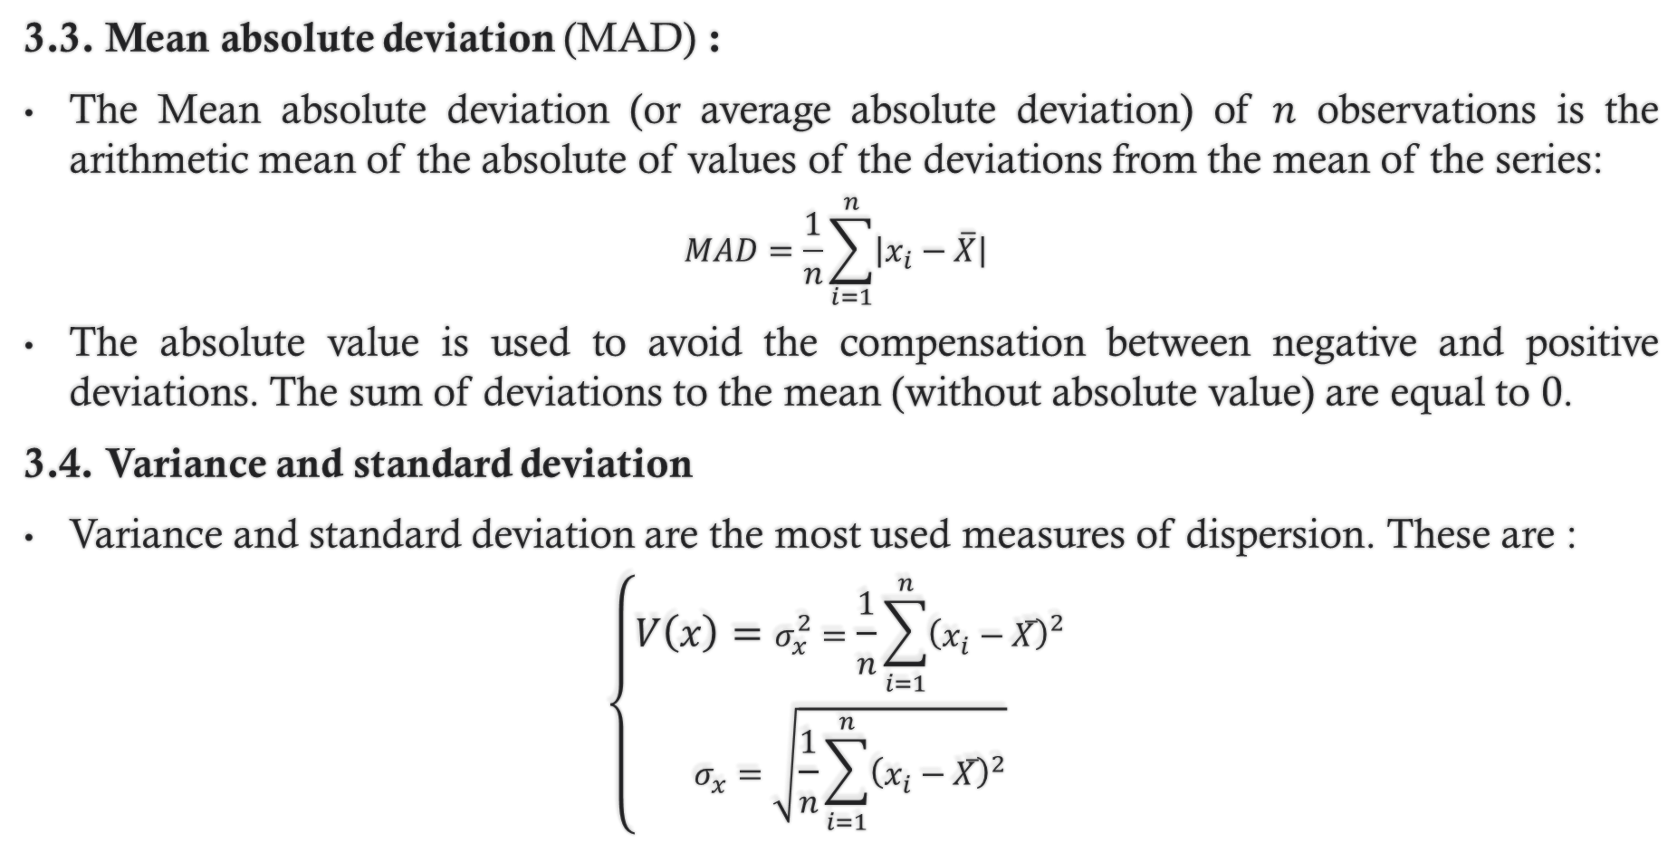
3. Measures of dispersion
3.3. Mean absolute deviation (MAD) :
The Mean absolute deviation (or average absolute deviation) of $n$ observations is the arithmetic mean of the absolute of values of the deviations from the mean of the series:
$$MAD=\frac{1}{n}\sum_{i=1}^{n}{\left|x_{i}−\overline{X}\right|}$$
The absolute value is used to avoid the compensation between negative and positive deviations. The sum of deviations to the mean (without absolute value) are equal to 0.
3.4. Variance and standard deviation
Variance and standard deviation are the most used measures of dispersion. These are :
$$\left\{\begin{aligned}V\left(x\right)=σ_{x}^{2}=\frac{1}{n}\sum_{i=1}^{n}{{\left(x_{i}−\overline{X}\right)}^{2}} \\ σ_{x}=\sqrt{\frac{1}{n}\sum_{i=1}^{n}{{\left(x_{i}−\overline{X}\right)}^{2}}}\end{aligned}\right.$$
Standard deviation is the square root of the variance

Slide 13
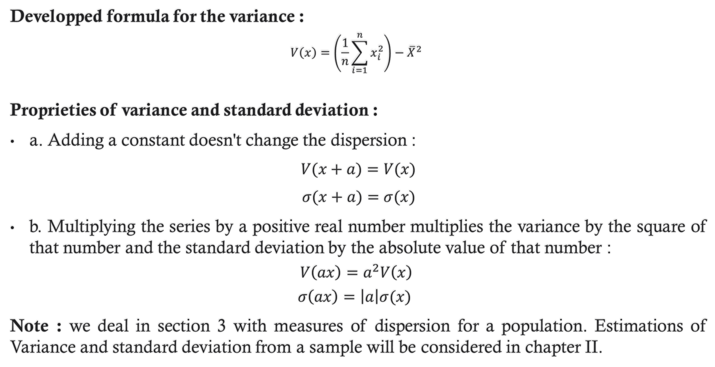
3. Measures of dispersion
Developped formula for the variance :
$$V\left(x\right)=\left(\frac{1}{n}\sum_{i=1}^{n}{x_{i}^{2}}\right)−{\overline{X}}^{2}$$
Proprieties of variance and standard deviation :
a. Adding a constant doesn't change the dispersion :
$V(x+a)=V(x)$
$σ(x+a)=σ(x)$
b. Multiplying the series by a positive real number multiplies the variance by the square of that number and the standard deviation by the absolute value of that number :
$$V\left(ax\right)=a^{2}V\left(x\right)$$
$$σ\left(ax\right)=\left|a\right|σ(x)$$
Note : we deal in section 3 with measures of dispersion for a population. Estimations of Variance and standard deviation from a sample will be considered in chapter II.

Slide 14

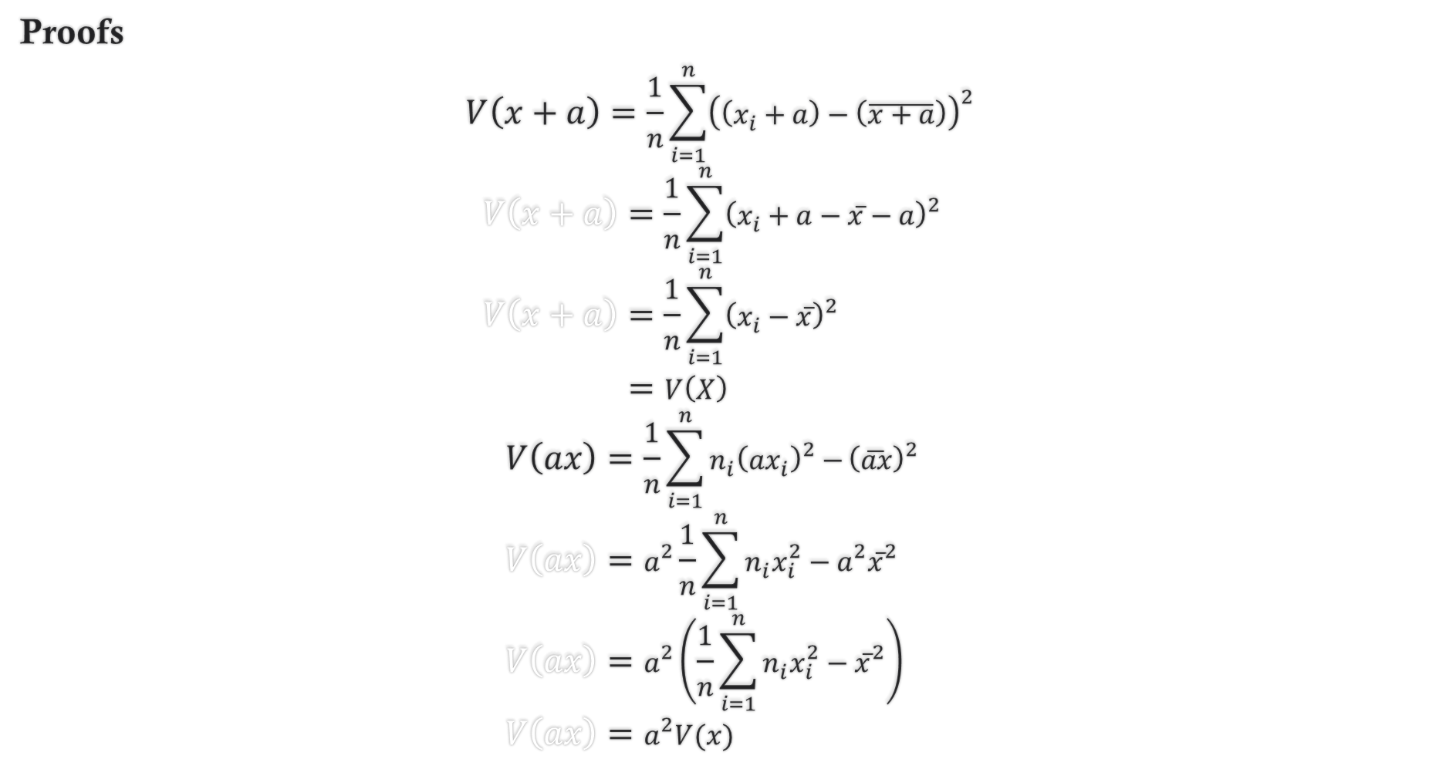

Proofs
$$V\left(x+a\right)=\frac{1}{n}\sum_{i=1}^{n}{{\left(\left(x_{i}+a\right)−\left(\overline{x+a}\right)\right)}^{2}}$$
$$V\left(x+a\right)=\frac{1}{n}\sum_{i=1}^{n}{{\left(x_{i}+a−\overline{x}−a\right)}^{2}} \\ V\left(x+a\right)=\frac{1}{n}\sum_{i=1}^{n}{{\left(x_{i}−\overline{x}\right)}^{2}}$$
$=V\left(X\right)$
$$V\left(ax\right)=\frac{1}{n}\sum_{i=1}^{n}{n_{i}{\left(ax_{i}\right)}^{2}−}{\left(\overline{ax}\right)}^{2} \\ V\left(ax\right)=a^{2}\frac{1}{n}\sum_{i=1}^{n}{{n_{i}x}_{i}^{2}}−a^{2}{\overline{x}}^{2} \\ V\left(ax\right)=a^{2}\left(\frac{1}{n}\sum_{i=1}^{n}{{n_{i}x}_{i}^{2}}−{\overline{x}}^{2}\right) \\ V\left(ax\right)=a^{2}V(x)$$
a.
(u$sing \overline{x+a}=\overline{x}$+a)
b.
(using $\overline{ax}=a\overline{x})$

Slide 15
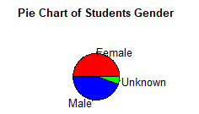
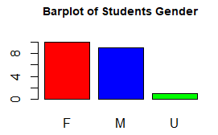
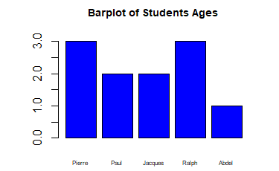
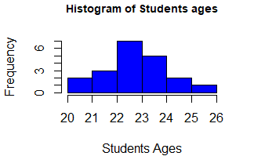
4. Data Visualization
4.1. Graphs for qualitative variables :
Pie chart :
4.2. Graphs for quantitative variables :
Discrete variables : Barplot
Barplot :
Continuous variables : Histogram

Slide 16
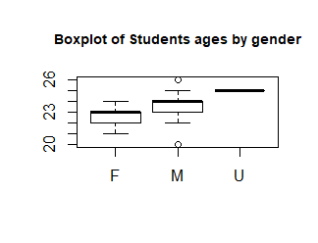
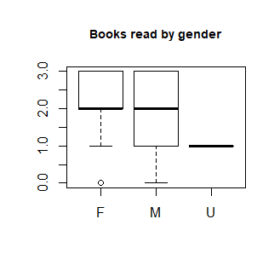
4. Data Visualization
4.3. Mixing quantitative and qualitative variables :
Boxplot :

